Slide 1
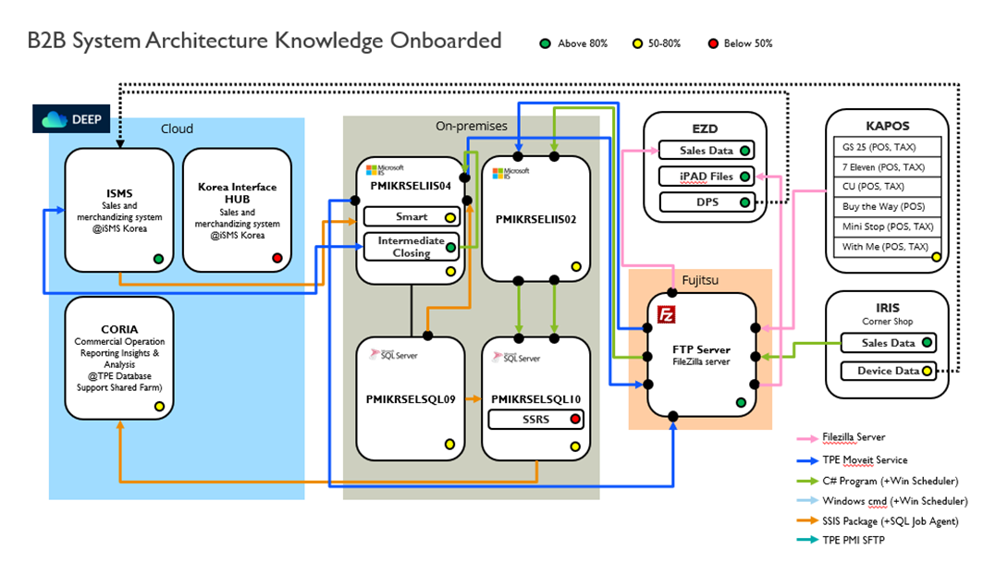
AS - IS

Slide 2

TO - BE
Cloud DataBase
Scheduler
Shared Folder
AWX
(SSIS & T-SQL)
DWH32
(SQL10)
Source File
ISMS
txt, csv, xml, dat
DWH31
(SQL09)
( KAPOS, KATAX, SIS, IRIS, EPSCONTRACT, 3PEcom, Ecomm )
Target File
pmisapgmp01
CORIA
UDIST.txt
EZD

